Slide 1

Web Traffic Time Series Analysis
Presented By-
Anjana Puvvada
Srushtee Pawar

Slide 2

Introduction
What Is Time Series Analysis?
Time series analysis is a statistical technique of analyzing a sequence of data points collected over time.
Time series data means that data is in a series of periods or intervals.
There are three major components in time series data i.e., trend, seasonality, and noise.
We analyze time series data to forecast the future.
Notes:
Trend: this is a long-term movement of the time series, such as the decreasing average heart rate of workouts as a person gets fitter.
Seasonality: regular periodic occurrences within a time interval smaller than a year (e.g., higher step count in spring and autumn because it’s not too cold or too hot for long walks).
Cyclicity: repeated fluctuations around the trend that are longer in duration than irregularities but shorter than what would constitute a trend. In our walking example, this would be a one-week sightseeing holiday every four to five months.
Irregularity: short-term irregular fluctuations or noise
A typical example of time-series data is stock prices or a stock market index.

Slide 3
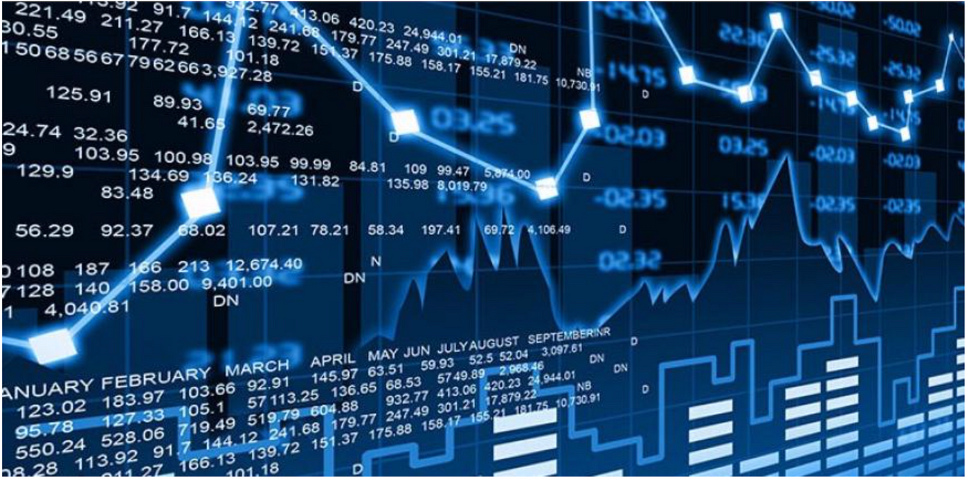
About Dataset
Source: Provided by Google Inc, and hosted on Kaggle
Data Extraction: API
This dataset contains the daily count of unique user visits to 145,063 Wikipedia articles
Timeframe: July 1st, 2015, to December 31st, 2016
Limitation: The dataset used for this analysis does not differentiate between missing data and zero page views
Wikipedia Article Web Traffic Time Series Analysis
Notes:
To overcome this limitation, careful considerations need to be made for how to handle missing data, such as by performing missing value imputations or removing specific rows of data with too many missing values

Slide 4
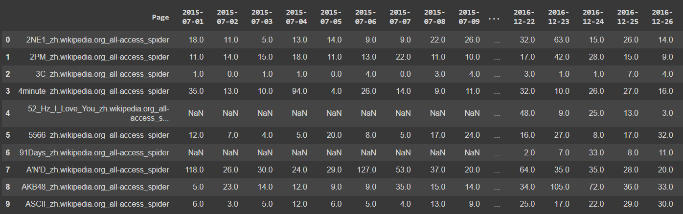
The Dataset
Notes:
Each article name has the following format: 'name_project_access_agent' .

Slide 5
Data Exploration and Cleaning
API command to extract the data from Kaggle
Handling Null Values
Transforming Data: Rearranging Rows and Columns for Time Series Analysis
Shape - Rows – 145063, Columns - 550
Notes:
we are extracting the data here using the API command from the kaggle .we have created a new token
which contained username and unique key data
Zip - unzip
Another concern about the data is the overall size of the dataset and lack of needed computation power

Slide 6

How is data distributed based on different types Wikipedia articles?
Project (e.g. en.wikipedia.org), Type of Access (e.g. desktop) and Type of Agent (e.g. spider)
Notes:
The page names contain the Wikipedia project (e.g. en.wikipedia.org), type of access (e.g. desktop) and type of agent (e.g. spider). In other words, each article name has the following format: 'name_project_access_agent' (e.g. 'AKB48_zh.wikipedia.org_all-access_spider').

Slide 7
The Dataset
Notes:
The page names contain the Wikipedia project (e.g. en.wikipedia.org), type of access (e.g. desktop) and type of agent (e.g. spider). In other words, each article name has the following format: 'name_project_access_agent' (e.g. 'AKB48_zh.wikipedia.org_all-access_spider').

Slide 8
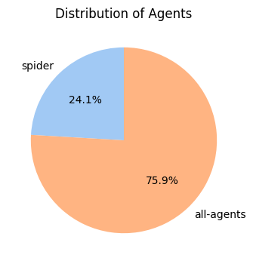
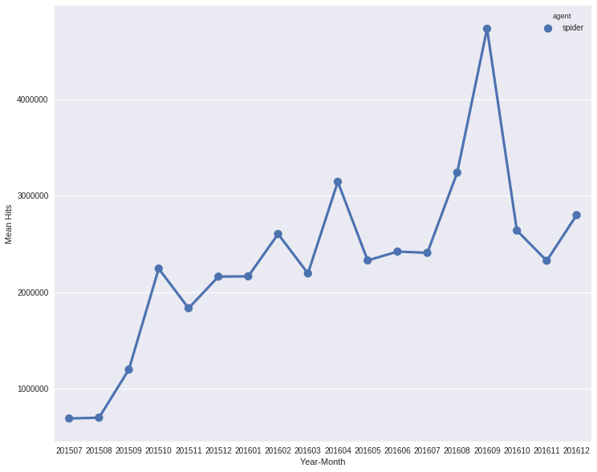
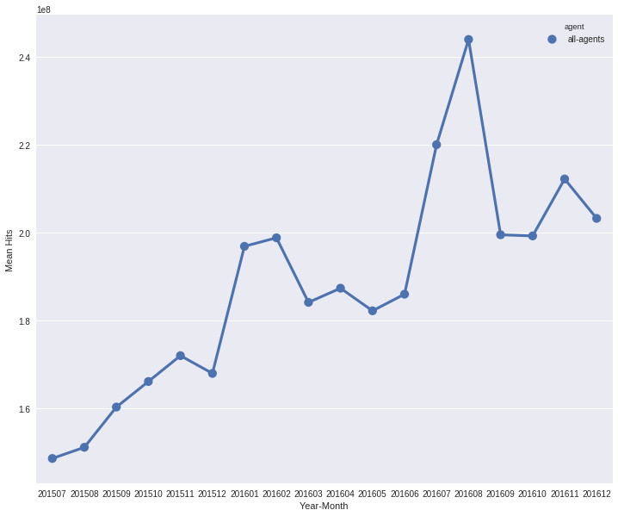
Spider
Type of Agent
Each article name has the following format: 'name_project_access_agent' .
Agent
Search engine crawlers/Spider: These are bots that are used by search engines to index the content of the Wikipedia. Ex. Google, Bing
All agents: This includes bots that are used for tasks such as editing Wikipedia articles, detecting spam, and monitoring website performance.
Notes:
What is a spider in web page?
spider traffic is access to a site from a web-crawler that was developed to collect data
There is a peak in the total traffic around late summer of 2016, and this is potentially due to the November 2016 US presidential election, and resulted in large views in pages of the candidates and other political topics included in this data set.
steep declines in the beginning and ending of the time series, and a large peak around the middle of 2016

Slide 9
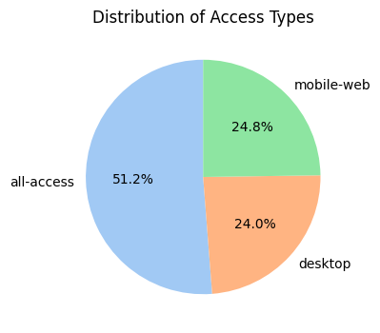
Type of access
Each article name has the following format: 'name_project_access_agent' .
All other access: This includes access from devices such as tablets, e-readers, and smart TVs. It also includes access from non-web browsers, such as Wikipedia apps.
Percentage of missing values in each access type is almost same. So there is no pattern in missing values.

Slide 10
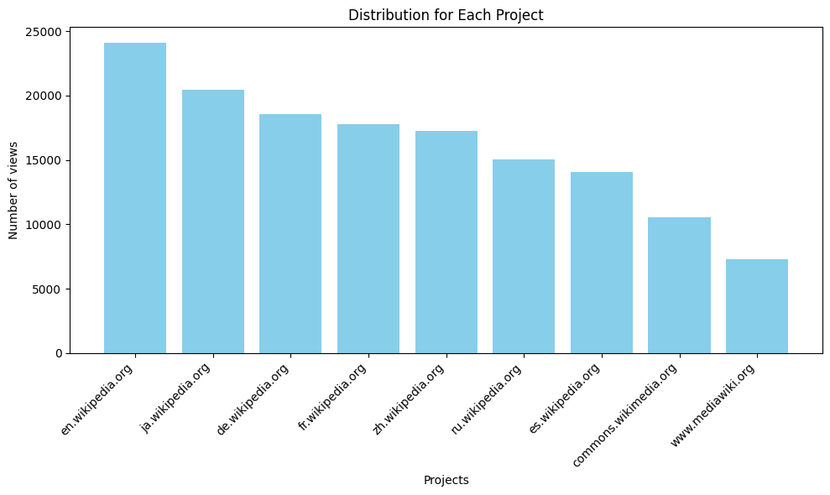
Type of Project
Each article name has the following format: 'name_project_access_agent' .
English Wikipedia (en.wikipedia.org) is the most popular Wikipedia project, with over 20 billion page views followed by Japanese Wikipedia with over 15 billion page views, the German Wikipedia with over 10 billion page views
Columns with projects commons.wikimedia.org and www.mediawiki.org have 48% columns with null values
In all three types, there exists the same patterns observed above in the overall traffic views, of steep declines in the beginning and ending of the time series, and a large peak around the middle of 2016
Notes:
We are unsure if they should be treated as zero visits to a Page on a specific day or maybe something happened on the server end and failed to update numbers.

Slide 11

Is Traffic Influenced by Page Language?
Unit of Analysis: Language

Slide 12
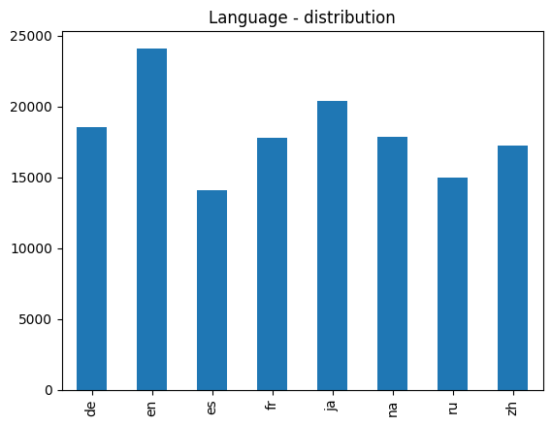
Comparison by Languages
The graph shows that the most popular language on Wikipedia is English, with over 30% of all page views. It is followed by Japanese (10%), German (7%), French (7%), and Russian (6%).
The most popular languages on Wikipedia are also the most widely spoken languages in the world.
Wikipedia is available in more languages than any other website. This makes it more accessible to people from all over the world.

Slide 13
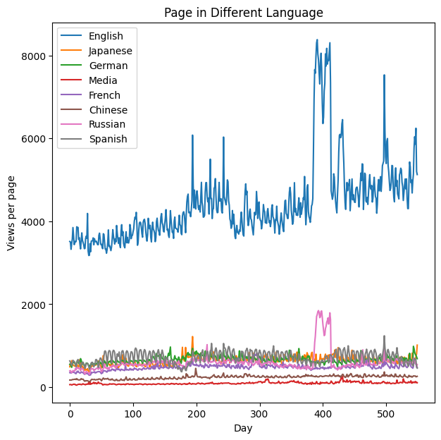
Comparison by Languages
English dominance: As expected, English has a significantly higher number of views per page, likely due to Wikipedia's US origins and the prevalence of English online
Unexpected structure: The presence of clear patterns and spikes in the data is surprising, suggesting factors beyond random fluctuations
Event-driven spikes: The large spikes in English and Russian data around day 400 (August 2016) as likely coinciding with the Summer Olympics and the US election, respectively.

Slide 14

Forecast Model
LSTM Model
ARIMA Model

Slide 15
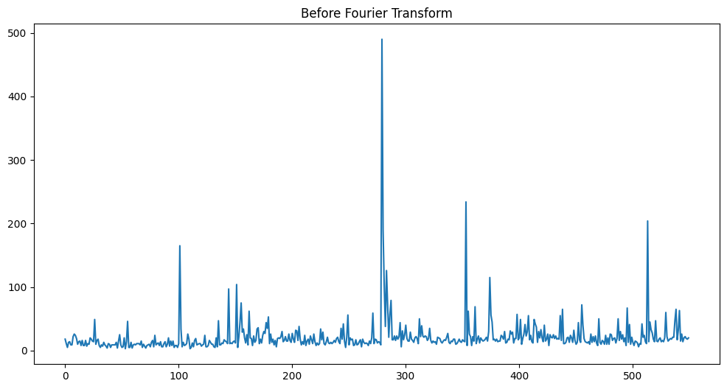
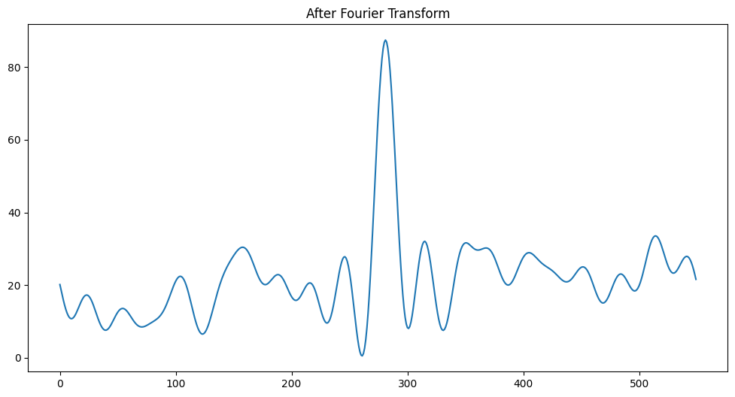
LSTM Model
Long Short-Term Memory is a type of recurrent neural network capable of learning order dependence in sequence prediction problems.
LSTMs are explicitly designed to avoid the long-term dependency problem. Remembering information for long periods is practically the default behavior. In standard RNNs, this repeating module will have a very simple structure, such as a single tanh layer.

Slide 16
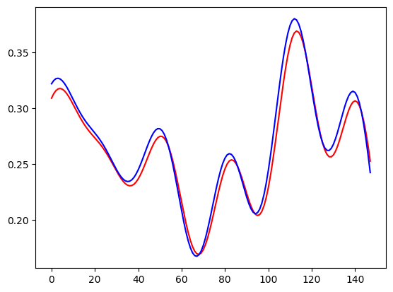
LSTM Model
The plot of the predicted web traffic values (red) and the actual web traffic values (blue).
The predicted values seem to follow the general trend of the actual web traffic values, but there are some discrepancies.
This is not surprising, as LSTM models are not perfect and can make mistakes.

Slide 17
ARIMA Model
ARIMA stands for AutoRegressive Integrated Moving Average. It is a class of statistical models for analyzing and forecasting time series data.
A quick breakdown of the components of the ARIMA model:
AR- AutoRegression: Model that uses the dependent relationship between an observation and some number of lagged observations.
I- Integrated: The use of differencing of raw observations in order to make the time series stationary.
MA- Moving Average: A model that uses the dependency between an observation and a residual error from a moving average model applied to lagged observations.
ARIMA models describe the trends and seasonality in time series as a function of lagged values and Averages changing over time intervals.

Slide 18
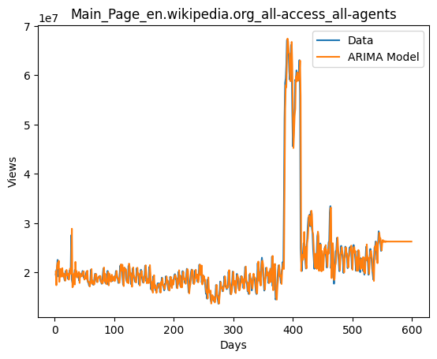
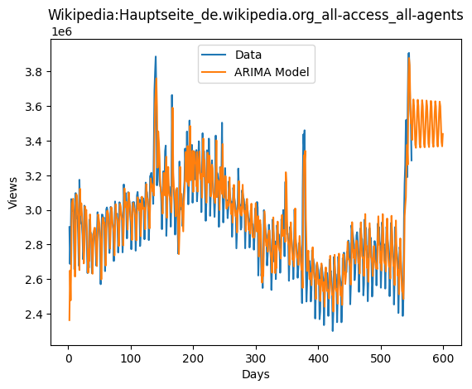
ARIMA Model
The ARIMA model seems to have captured the general trend of the web traffic data, but it is not perfectly accurate.
There are some discrepancies between the predicted values and the actual values, especially in the latter part of the time series.
ARIMA models are also sensitive to the order of the model, which is the number of autoregressive (AR), integrated (I), and moving average (MA) terms in the model.
In this case, the ARIMA model was fitted with an order of (2, 1, 4), which is a common order for many time series datasets.
Overall, the ARIMA model is able to capture the general trend of the data and can be used to make reasonable predictions about future web traffic.

Slide 19
Further Exploration
Seasonality and Trends
Analyze the data for recurring seasonal patterns (e.g., weekdays, months) and long-term trends (e.g., yearly growth)
External Factors
Consider additional data sources that might influence web traffic, like holidays, weather, or social media trends. Incorporate these factors into the model as features or use them to adjust predictions dynamically. This provides a more holistic view of web traffic and improves prediction accuracy by accounting for external influences.
Explainability and Interpretability
Use models that explain their predictions, such as decision trees or rule-based models. This helps to understand why the model makes certain predictions and gain insights into the factors affecting web traffic.

Slide 20

Thank You

